Slide 1
Project Proposal
Presentation by Pasha Aksoy

Slide 2

Customer: Mythic Quest HQ
Who is Mythic Quest HQ?
Renowned game developer
Why is a network redesign required
Moving to new office building
Increase network security
Increase network reliability
Future-proof network

Slide 3
Who is Mythic Quest HQ?
Large renowned video game company
6 individual departments
125 total laptop hosts
125 Employees
Every employee should have access to a laptop
30 Game consoles

Slide 4
How can we meet the needs of Mythic Quest?
Present
Implement a network design that can support 6 departments and current employees.
Support IT operations
Increase network speed and reliability
Future
Implement a network design that allows for scalability
Implement proper security measures to prevent/mitigate attacks

Slide 5
Project Overview
Scalability
Room for 8 individual subnets
Only 6 in use currently
Room for growth, especially by splitting remaining subnets further and using VLAN
Room for scalability using VLAN connections if needed
Room for 8,190 usable hosts
Includes laptops and game consoles
Per subnet (department)
Allows for substantial growth
Network Addressing
DHCP automatic addressing on devices
Added IPv6 capability to future-proof network

Slide 6
Project Overview
Security
Network Segmentation
Each department subnet is connected via its own router
Each department subnet uses a secure switch and has its own server connected
Administration may connect remotely via SSH
Securing Network Devices
Enable and Console password implemented on every router & switch
Password policy enforcement on end-devices
Secure unused ports
Disabled VTY ports on routers
Use of VLAN
Blackhole unused ports on switches

Slide 7
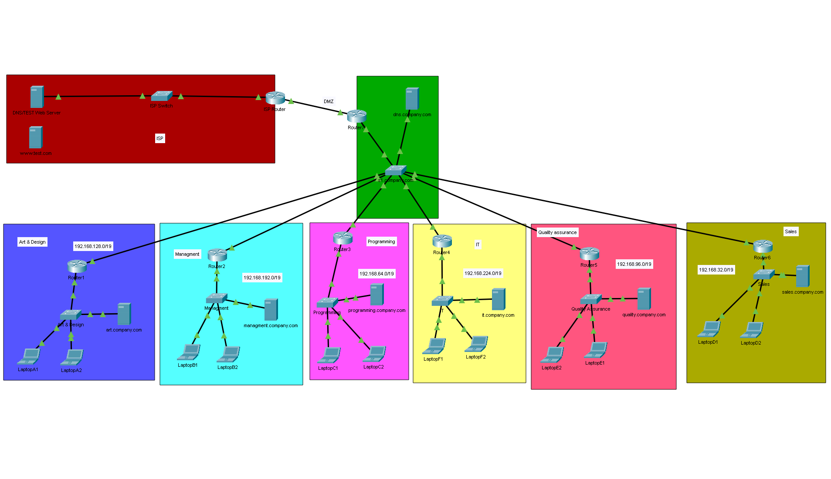
Project Overview
Network Design

Slide 8
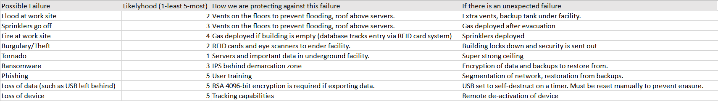
Contingency Planning
Most Likely Failures:
Fire at site
Phishing
Loss of Device/Data
Solutions
Proper cabling
Proper anti-fire measures
Phishing training
Remote access tools

Slide 9
Conclusion
Implement a network design that can support current requirements
Support IT operations
Increase network speed and reliability
Allow for department segmentation
Additional Considerations
Implement a network design that allows for scalability
Implement proper security measures to prevent/mitigate attacks
Future-proof network

